Slide 1
Secure Text and Voice Chat Implementation UsingRING- LWE and ChaCha20 Cryptography
Rubesh VC - 2021506075
Shyaam S - 2021506099

Slide 2
Introduction
Lattice based cryptography like Ring Learning with Errors (RING -LWE) with ChaCha20 is used to ensure strong security against classical and quantum attacks, so that we can ensure a secure data transmission in a Secure Text and video chat application.
Unlike pre existing encryption methodologies on texting app security, a new approach of encryption and decryption is followed in this project

Slide 3
Objective
1. To Generate key using Ring LWE cryptography
2. To encrypt and decrypt text message
3. To encrypt and decrypt voice message

Slide 4
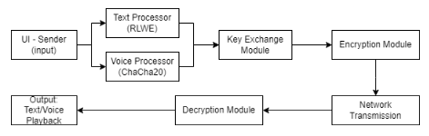
BLOCK DIAGRAM – KEY GENERATION and encryption

Slide 5
Features of hash generation
Ring Structures
Hardness of the Problem
Noise in the System
Efficiency
Security Reductions

Slide 6
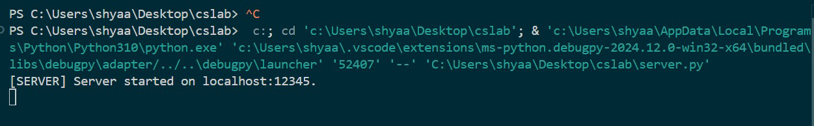
ENCRYPTION
Server initiation

Slide 7
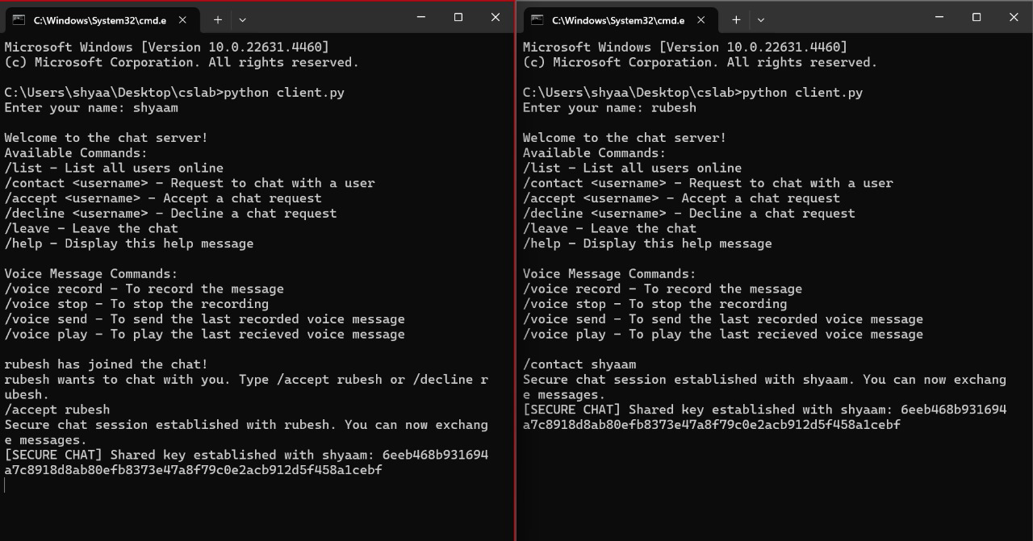
Key establishment using R- LWE
Shared key establishment

Slide 8
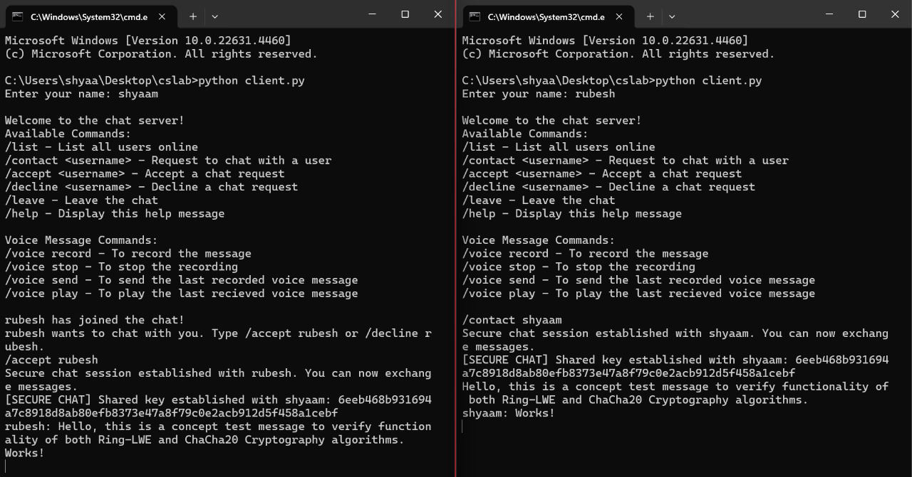
Text message test
Message Test

Slide 9
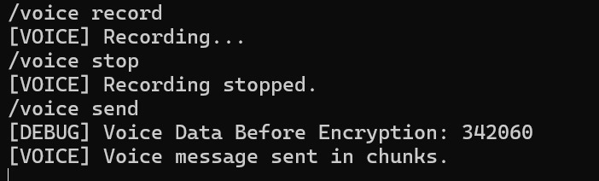
Voice message test
Sender sending voice message

Slide 10
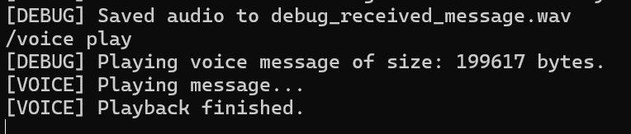
Voice message test
Receiver side response

Slide 11
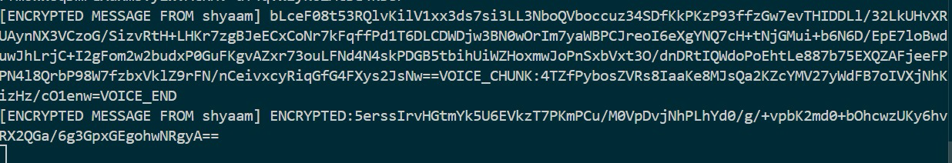
Encrypted message
Encrypted message at server

Slide 12
Conclusion
A Secure chat application was implemented as proposed by Ring LWE and ChaCha20. The integration of these modules were implemented by incorporating the Ring LWE and ChaCha20 which in turn helped in encrypting and decrypting a text or voice message sent through our secured messaging application.
the project ensures secure communication and also increases error handling with authentication. further real-time voice streaming also have been tried in this project. produces a novelty of integrating two security standards

Slide 13
Thank you

